Slide 1
This paperwork has been done by : Faisal M. Al-Thobaiti Under the supervision of: Mr.Mohammed Musatafa Shoaa Al-Marifaa High School

Slide 2
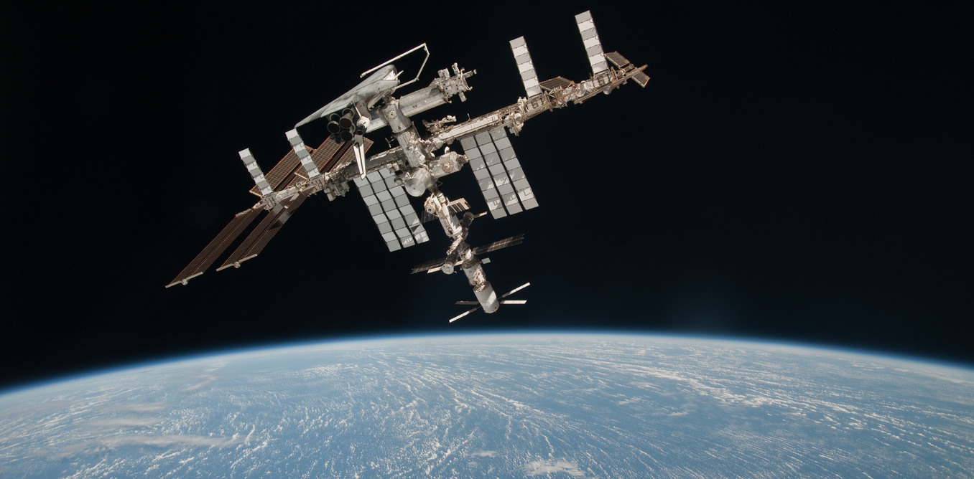
International Space Station
Assembly of the International Space Station (ISS) is a remarkable achievement. Since November 2, 2000, humankind has maintained a continuous presence in space. Over this timespan, the ISS International Partnership has flourished. We have learned much about construction and about how humans and spacecraft systems function on orbit. But there is much more to do and learn, and this voyage of research and discovery is just beginning
This was the letter that William H. Gerstenmaier sent to the world about
the astablish of the International Space Station (ISS)

Slide 3
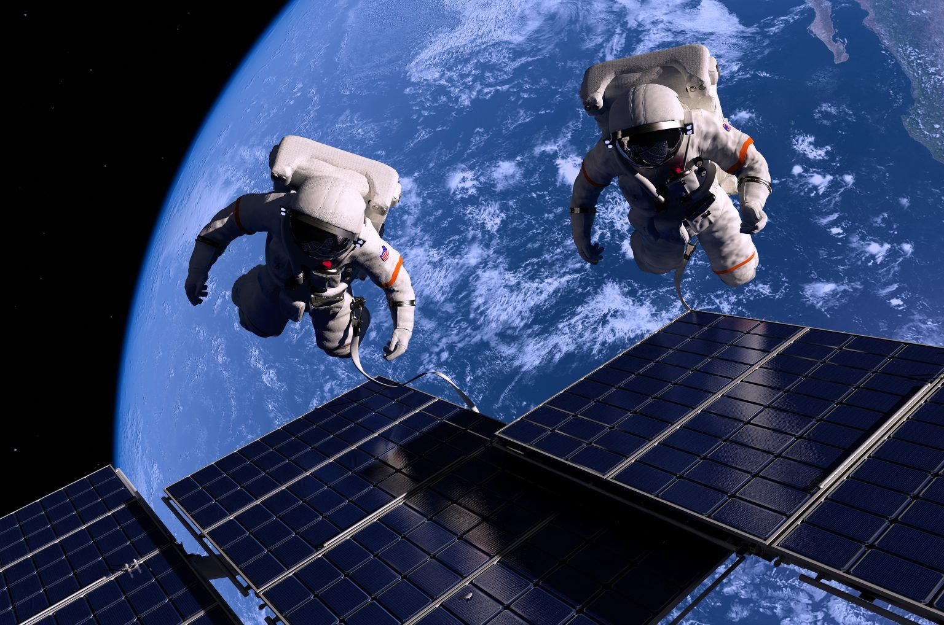
The International Space Station (ISS) is the largest modular space station currently in low Earth orbit. It is a multinational collaborative project involving five participating space agencies: NASA (United States), Roscosmos (Russia), JAXA (Japan), ESA (Europe), and CSA (Canada).^{[7][8]} The ownership and use of the space station is established by intergovernmental treaties and agreements . The station serves as a microgravity and space environment research laboratory in which scientific research is conducted in astrobiology, astronomy, meteorology, physics, and other fields.^{[10][11][12]} The ISS is suited for testing the spacecraft systems and equipment required for possible future long-duration missions to the Moon and Mars

Slide 4
The ISS was originally intended to be a laboratory, observatory, and factory while providing transportation, maintenance, and a low Earth orbit staging base for possible future missions to the Moon, Mars, and asteroids. However, not all of the uses envisioned in the initial memorandum of understanding between NASA and Roscosmos have been realised. In the 2010 United States National Space Policy, the ISS was given additional roles of serving commercial, diplomatic, and educational purposes.
The purpose

Slide 5
The ISS provides a location in the relative safety of low Earth orbit to test spacecraft systems that will be required for long-duration missions to the Moon and Mars. This provides experience in operations, maintenance as well as repair and replacement activities on-orbit. This will help develop essential skills in operating spacecraft farther from Earth, reduce mission risks, and advance the capabilities of interplanetary spacecraft. Referring to the MARS-500 experiment, a crew isolation experiment conducted on Earth, ESA states that "Whereas the ISS is essential for answering questions concerning the possible impact of weightlessness, radiation and other space-specific factors, aspects such as the effect of long-term isolation and confinement can be more appropriately addressed via ground-based simulations". Sergey Krasnov, the head of human space flight programmes for Russia's space agency, Roscosmos, in 2011 suggested a "shorter version" of MARS-500 may be carried out on the ISS.
Exploration

